Slide 1
Introduction to Operating System

Slide 2
the low-level software that supports a computer's basic functions, such as scheduling tasks and controlling peripherals.

Slide 3
A program that acts as an intermediary between a user of a computer and the computer hardware.
An OS is a program which acts as an interface between computer system users and the computer hardware.

Slide 4
It provides a user-friendly environment in which a user may easily develop and execute programs.
Otherwise, hardware knowledge would be mandatory for computer programming.
So, it can be said that an OS hides the complexity of hardware from uninterested users.

Slide 5
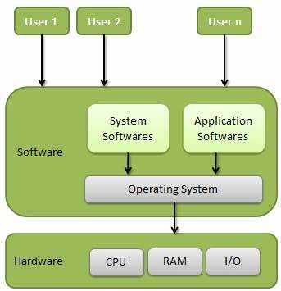

Slide 6
In general, a computer system has some resources which may be utilized to solve a problem. They are
  Memory
  Processor(s)
  I/O
  File System
  etc.

Slide 7
Following are some of important functions of an operating System.
Memory Management
Processor Management
Device Management
File Management
Security
Control over system performance
Job accounting
Error detecting aids
Coordination between other software and users

Slide 8
Memory Management
handles or manages primary memory and moves processes back and forth between main memory and disk during execution.
keeps track of each & every memory location

Slide 9
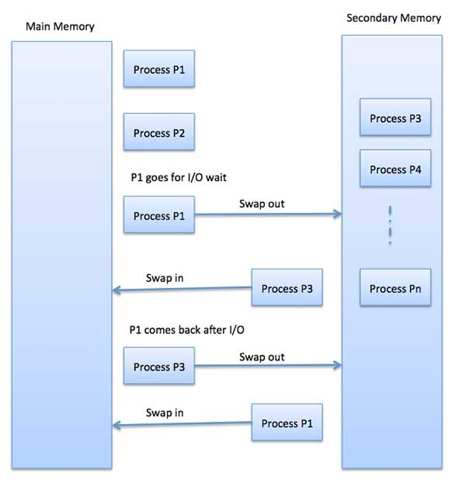

Slide 10
Processor Management
Keeps tracks of processor and status of process.
Allocates the processor (CPU) to a process.
De-allocates processor when a process is no longer required.

Slide 11
Device Management
Keeps tracks of all devices. Program responsible for this task is known as the I/O controller.
Allocates the device in the efficient way
De-allocates devices.

Slide 12
File Management
Keeps track of information, location, uses, status etc. The collective facilities are often known as file system.

Slide 13
General Definition
In a more simplistic approach, in fact, OS itself is a program.
But it has a priority which application programs don’t have.
OS uses the kernel mode of the microprocessor, whereas other programs use the user mode.
The difference between two is that; all hardware instructions are valid in kernel mode, where some of them cannot be used in the user mode.

Slide 14
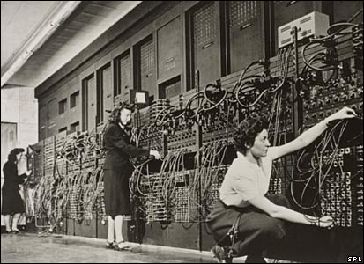
History of Operating Systems
It all started with computer hardware in about 1940s.
ENIAC 1943

Slide 15
History of Operating Systems
ENIAC (Electronic Numerical Integrator and Computer), at the U.S. Army's Aberdeen Proving Ground in Maryland.
  built in the 1940s,
  weighed 30 tons,
  was eight feet high, three feet deep, and 100 feet long
  contained over 18,000 vacuum tubes that were cooled by 80 air blowers.

Slide 16
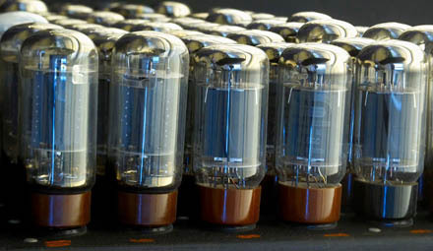
History of Operating Systems
Computers were using vacuum tube technology.
ENIAC’s vacuum tubes

Slide 17
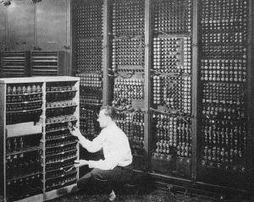
History of Operating Systems
ENIAC’s backside

Slide 18
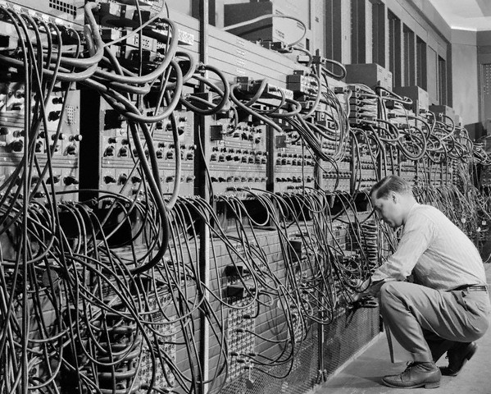
History of Operating Systems
Programs were loaded into memory manually using switches, punched cards, or paper tapes.
ENIAC : coding by cable connections

Slide 19
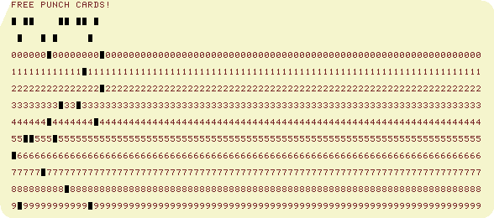
History of Operating Systems
punch card

Slide 20
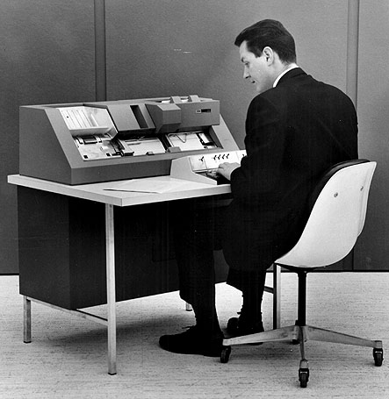
History of Operating Systems

Slide 21
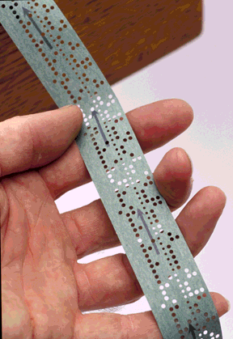
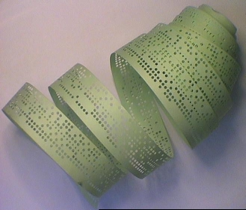
History of Operating Systems
Paper tape

Slide 22
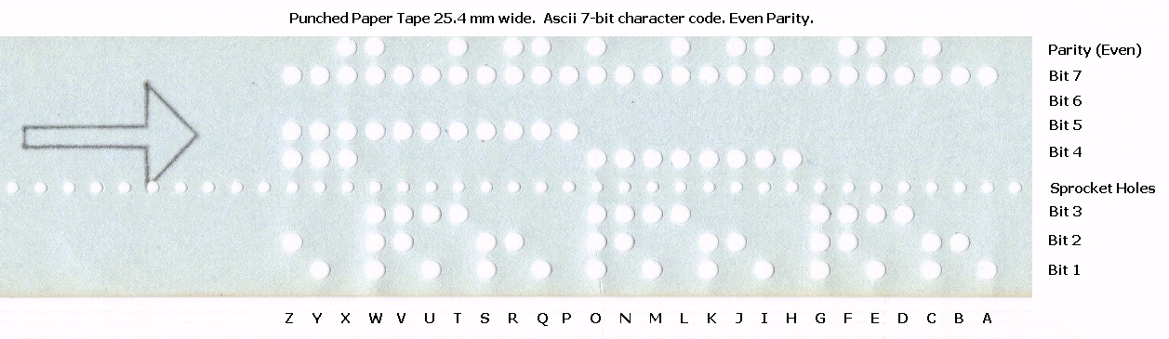
History of Operating Systems

Slide 23
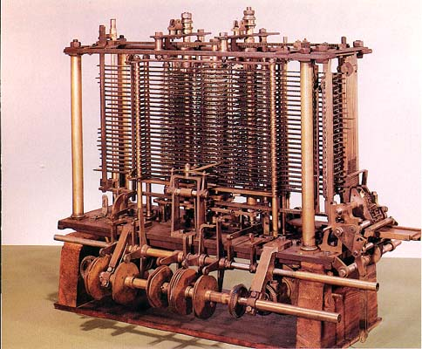
History of Operating Systems
Babbage’s analytical engine
(designed in 1840’s by Charles Babbage, but cold not be constructed by him.
An earlier and simpler version is constructed in 2002, in London )
http://www.computerhistory.org/babbage/

Slide 24
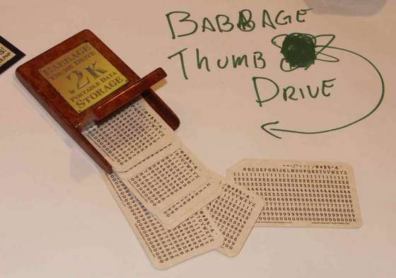
History of Operating Systems
Ada Lovalence (at time of Charles Babbage) wrote code for analytical engine to compute Bernulli Numbers

Slide 25
History of Operating Systems
As time went on, card readers, printers, and magnetic tape units were developed as additional hardware elements.
Assemblers, loaders and simple utility libraries were developed as software tools.
Later, off-line spooling and channel program methods were developed sequentially.

Slide 26
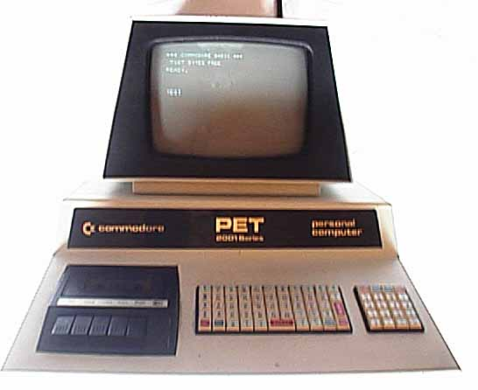
History of Operating Systems
Commodore PET, 1977

Slide 27
History of Operating Systems
Finally, the idea of multiprogramming came.
Multiprogramming means sharing of resources between more than one processes.
By multiprogramming the CPU time is not wasted, because, while one process moves on some I/O work, the OS picks another process to execute till the current one passes to I/O operation.

Slide 28
1.2 History of Operating Systems
With the development of interactive computation in 1970s, time-sharing systems emerged.
In these systems, multiple users have terminals (not computers) connected to a main computer and execute her task in the main computer.

Slide 29


1.2 History of Operating Systems
Main computer; having a CPU executing processes by utilization of the OS, (e.g. UNIX).
Terminals are connected to the main computer and used for input and output. No processing is made. They do not have CPUs.

Slide 30
History of Operating Systems
Another computer system is the multiprocessor system having multiple processors sharing memory and peripheral devices.
With this configuration, they have greater computing power and higher reliability.

Slide 31
History of Operating Systems
Multiprocessor systems are classified into two as tightly-coupled and loosely-coupled (distributed).
In the tightly-coupled one, each processor is assigned a specific duty but processors work in close association, possibly sharing the same memory.
In the loosely coupled one, each processor has its own memory and copy of the OS.

Slide 32
History of Operating Systems
Use of the networks required OSs appropriate for them.
In network systems, each process runs in its own machine but the OS have access to other machines.
By this way, file sharing, messaging, etc. became possible.
In networks, users are aware of the fact that s/he is working in a network and when information is exchanged. The user explicitly handles the transfer of information.

Slide 33
History of Operating Systems
Each is a computer having its own CPU, RAM, etc. An OS supporting networks is installed on them.

Slide 34
History of Operating Systems
Distributed systems are similar to networks. However in such systems, there is no need to exchange information explicitly, it is handled by the OS itself whenever necessary.
With continuing innovations, new architectures and compatible OSs are developed. But their details are not in the scope of this text since the objective here is to give only a general view about developments in OS concept.

Slide 35
. Batch Operating System
input devices : card readers, tap drives
output devices : line printers, punch cards, tap drives
OS was very simple and resident in main memory
Prepare a job and submit to operator. Job was consisted of
program, data and some control information
sort them in batches with similar requirements, and as
computer became available, run them batch wise after some time (some hours or even after some days)
output appeared. Output includes result and error information.

Slide 36
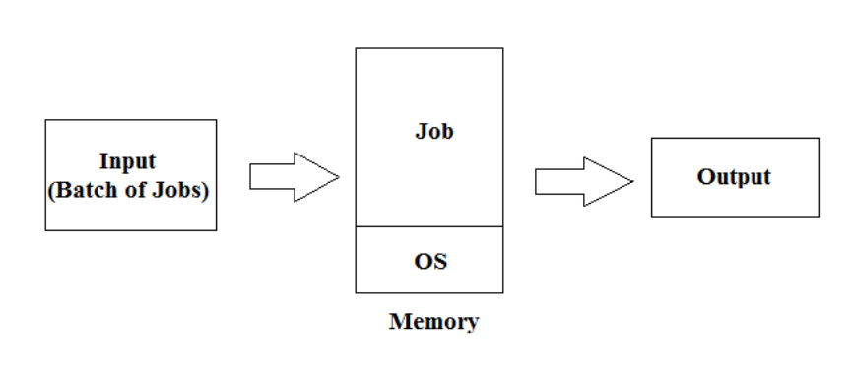

Memory Structure in Batch Operating System

Slide 37
Disadvantages :
Low throughput : CPU remains idle when I/O is going on
Programmers do not have direct interaction with Job
Debugging is possible only offline, after output appears
Operations were too much time consuming

Slide 38
Multiprogramming Operating System
Run more than one program concurrently
more than one program loaded in main memory simultaneously. These programs can be executed concurrently. Memory is shared between OS and such kind of programs.
Multiprogramming = Multitasking
significantly improves system throughput and resource
utilization
CPU can be utilized as much as possible. Eg. During I/O operation, CPU will be free, and it can be allocated to other Job.

Slide 39
Required Features :
better memory management and protection
swapping and virtual memory
CPU scheduling
Disk management and file system
Synchronization & communication between running programs and problems like deadlock should be overcome

Slide 40
Multi-user Operating System
Single user OS allows single user to access computer system at a time.
Multiple users cannot use single computer at a time. Eg. Situation at home
Multi-user allow multiple users to access computer system at a time
remote access is provided via a network, So that users can access the computer remotely using a terminal or other computer

Slide 41
A terminal contains I/O devices eg. ATM machine or computer at railway station
Multiple user can access the single computer through timesharing and multiprogramming
CPU is time-sliced at a regular interval
Eg. Unix, VMS and mainframe OS
The OS must make sure that
Each and every program executed by multiple users has sufficient and separate resource
Resources, such as printers, should be shared in fair and proper way

Slide 42
Request from one user should not affect the operation of other users
only authenticate and valid users should use the data stored on computers
Expensive hardware can be shared among several users using multi-user OS. This provides better utilization of resources.
As more users access it, the performance becomes slower and slower.
Cost of hardware and software in multi-user environment is more than single user OS.

